Slide 1
Intro to text analysis
Rongbo Jin
rongbojin@arizona.edu
University of Arizona
Research Bazaar Arizona 2023

Slide 2
An Overview of Methods
Two broad approaches to computational text analysis:
Supervised methods: We identify what we’re interested in first, and then use computers to extend our insights to a larger population of unseen documents.
Unsupervised methods: We do not specify the conceptual structure of the texts beforehand. Instead, we use the model to discover a structure that best explains the documents

Slide 3
Grimmer and Steward 2013

Slide 4
Principles of Computational Text Analysis
All Quantitative Models of Language Are Wrong – But Some Are Useful.
Quantitative methods for text amplify resources and augment humans.
There is no globally best method for automated text analysis.
Validate! Validate! Validate!

Slide 5
Important assumptions of text analysis
Texts can be represented through extracting their features
1. most common is the “bag of words” assumption
2. many other possible definitions of “features” (e.g. word embeddings)
A document-feature matrix can be analyzed using quantitative
methods to produce meaningful and valid estimates of the underlying
characteristic of interest

Slide 7
Key features of quantitative text analysis
Selecting texts: Defining the corpus
Conversion of texts into a common electronic format
Defining documents: deciding what will be the documentary unit of analysis (segmentation or aggregation)

Slide 8
Key features of quantitative text analysis
4. Defining and refining features. These can take a variety of forms,
including tokens, equivalence classes of tokens (dictionaries),
selected phrases, human-coded segments (of possibly variable
length), linguistic features, and more.
5. Conversion of textual features into a quantitative matrix
6. A quantitative or statistical procedure to extract information from
the quantitative matrix.
7. Summary and interpretation of the quantitative results

Slide 9
Key Concepts
corpus a large and structured set of texts for analysis
document each of the units of the corpus
types for our purposes, a unique word
tokens any word – so token count is total words

Slide 10
Exercise
Consider these two sentences
“The Research Bazaar is a worldwide festival promoting the digital literacy emerging at the center of modern research. ”
“Researchers at all levels from all disciplines should attend.”
Question: How many documents in this corpus? How many types and tokens in each document?

Slide 11
Exercise
Consider these two sentences
“The Research Bazaar is a worldwide festival promoting the digital literacy emerging at the center of modern research. ”
16 types, 18 tokens
“Researchers at all levels from all disciplines should attend.”
8 types, 9 tokens

Slide 12
Key concepts
stemming
cutting off the end or the beginning of the word, taking into account a list of common prefixes and suffixes that can be found in an inflected word, often leading to incorrect meanings and spelling.
lemmatization
considers the context and converts the word to its meaningful base form.

Slide 13
Exercise
Original form | Stem | Lemma
caring
programmers
because
programming

Slide 14
Exercise
Original form | Stem | Lemma
caring | car | care
programmers | program | programmer
because | becaus | because
programming | program | program

Slide 15
Key concept
Stop words
Stop words are a set of commonly used words in a language. Examples of stop words in English are “a,” “the,” “is,” “are,” etc. Stop words are commonly used in Text Mining and Natural Language Processing (NLP) to eliminate words that are so widely used that they carry very little useful information.

Slide 16
Key concepts
Types of stop words
Determiners – Determiners tend to mark nouns where a determiner usually will be followed by a noun
examples: the, a, an, another
Coordinating conjunctions – Coordinating conjunctions connect words, phrases, and clauses
examples: for, an, nor, but, or, yet, so
Prepositions – Prepositions express temporal or spatial relations
examples: in, under, towards, before

Slide 17
From words to numbers
1. Bag-of-words assumption
2. Pre-processing text
Capitalization, cleaning digits/URLs, removing stop words and sparse words…
Stemming
3. Document-term matrix
W: matrix of N documents by M unique words
Wim = number of times m-th words appears in i -th document.
Usually large matrix, but sparse (so it fits well in memory)

Slide 18
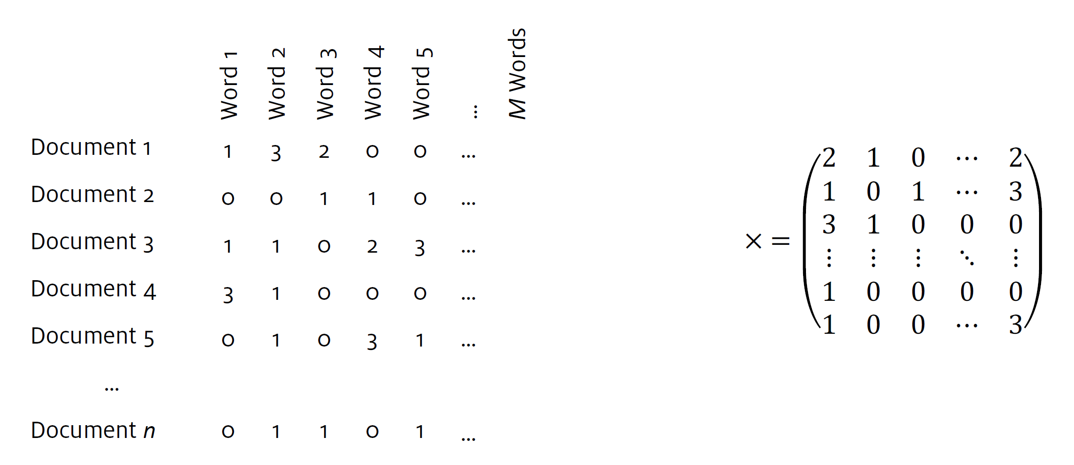
Document-term matrix (or DTM)

Slide 19
Lab Session

